Slide 1


Data analysis and visualization of Netflix content Reports and recommendations
.

Slide 2
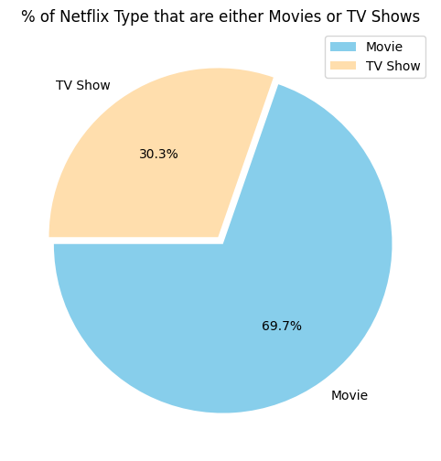
Chart 1 : Content type distribution
•
Content type distribution: The majority of the content on the Netflix is Movie(69.7%).

Slide 3
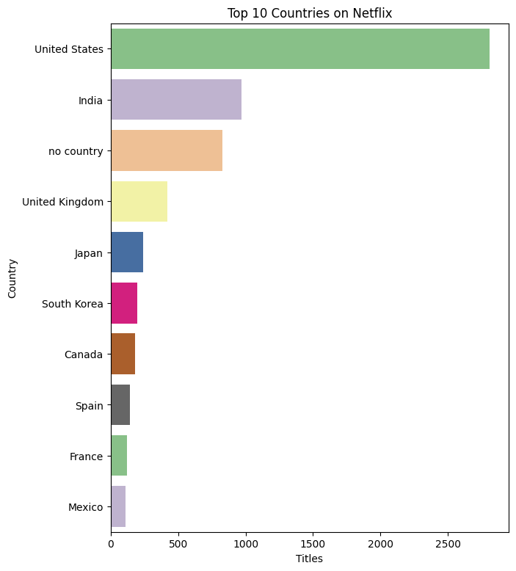
Chart 2 : Country distribution
• Country distribution: The United States has the largest numbers of contents on Netflix followed by India and United Kingdom.

Slide 4
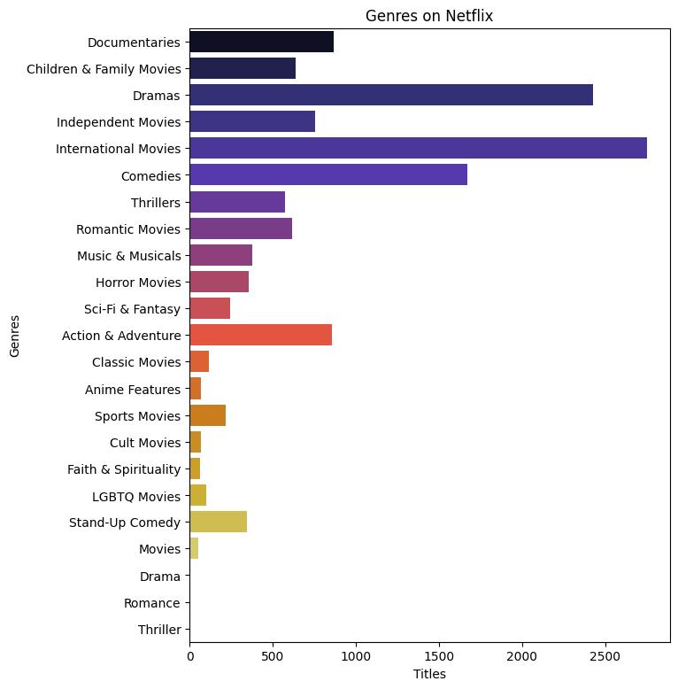
Chart 3: Popular genres
• Popular genres: Here we can see that International Movies has the highest numbers of content on Netflix within the period.

Slide 5
Acknowledgments
I would like to express my sincere gratitude to myself for the diligent effort and meticulous analysis invested in this Netflix Data Analysis project. From data extraction to visualization, every step of the analytical process was meticulously executed. The accuracy and reliability of the findings presented in this report are a testament to the dedication and expertise applied throughout the analysis.

